Slide 1
Public Entity Insurance Marketplace, Trends, Industry Issues and Outlook
Presented by: Doug Wozniak
SDRMA
March 26, 2024
Alliant Insurance Services
www.alliant.com
(THIS INFORMATION HAS BEEN CONSOLIDATED FROM VARIOUS INDUSTRY SOURCES)

Slide 2
Policyholder Surplus (Capacity), 2010: Q1 – 2023: F1*
The P/C insurance industry entered the COVID-19 pandemic from a position of strength and was able to withstand the 9.0% surplus decline in Q1 2020 (far less than during the Financial Crisis). 2020 ended with record surplus. 2021 set another new record, exceeding $1 trillion for the first time. Unrealized losses caused surplus to drop sharply in 2022.
2022:H1
(-7.9%)
($ Billions)
Drop due to near-record
2011 CAT losses (-4.9%)
Policyholder Surplus is the industry’s financial cushion against large insured events, periods of economic stress and financial market volatility.
It is also a source of capital to underwrite new risks.
*2022 figure is actual through Q2.
Sources: ISO, A.M .Best, NAIC. Risk and Uncertainty Management Center, University of South Carolina.
Notes:
2
Remember one year ago we just got the yellow line, right after covid-19 set in, and the stock market dropped. We didn’t know what direction it would go next, it has recovered = insurance market is strong and signifies a financially safe method to transfer risk.

Slide 3
Net Investment Yield on Property/Casualty Insurance Invested Assets,
2003–2023P
Investment yields in 2021 were
depressed--down about 200 BP from
pre-crisis (and 50-80BP from pre-COVID) levels but are now rising. Yields in 2021 were the lowest since at least 1960.
(Percent)
The yield on invested assets remains depressed relative to pre-financial crisis and
pre-COVID yields. Fed rate hikes in 2022 should begin to slowly lift yields.
Average: 1960-2019 = 4.9% | Low: 2.8% (1961) | High: 8.2% (1984/85)
Sources: NAIC data, sourced from S&P Global Market Intelligence; 2017-19 figures are from ISO. 2020-21 data from the APCIA.
Risk and Uncertainty Management Center, Univ. of South Carolina.
3

Slide 4
Number of Years with Underwriting Profits by Decade, 1920s–2020s
Number of Years with Underwriting Profits
Underwriting Profits Were Common Before the 1980s (40 of the 60 Years Before 1980 Had Combined Ratios Below 100) –But Then They Vanished. Not a Single Underwriting Profit Was Recorded in the 25 Years from 1979 Through 2003
* 2020 through 2022
Note: Data for 1920–1934 based on stock companies only.
Sources: Insurance Information Institute research from A.M. Best Data.
4

Slide 5
Average # of Billion Dollar Disasters
Time Period | Billion-Dollar Disasters | Events/Year | Cost | Percent of Total Cost | Cost/Year
1980s (1980-1989) | 33 | 3.3 | $212.7B | 8.1% | $21.3B
1990s (1990-1999) | 57 | 5.7 | $324.6B | 12.4% | $32.5B
2000s (2000-2009) | 67 | 6.7 | $602.5B | 23.0% | $60.3B
2010s (2010-2019) | 131 | 13.1 | $964.4B | 36.9% | $96.4B
Last 5 Years (2018-2022) | 90 | 18.0 | $620.6B | 23.7% | $124.1B
Last 3 Years (2020-2022) | 60 | 20.0 | $454.3B | 17.4% | $151.4B
Last Year (2022) | 18 | 18.0 | $177.6B | 6.8% | $177.6B
All Years (1980-2023)* | 371 | 8.4 | $2,616.1B‡ | 100.0%‡ | $59.5B‡
The distribution of damage from U.S. Billion-dollar disaster events from 1980 to 2023 is dominated by tropical cyclone losses. Tropical cyclones have caused the most damage ($1,367.6 billion, CPI-adjusted) and have the highest average event cost ($22.8 billion per event, CPI-adjusted). Drought ($337.1 billion, CPI-adjusted), severe storms
($442.2 billion, CPI-adjusted) and inland flooding ($193.4 billion, CPI-adjusted) have also caused considerable damage based on the list of billion-dollar events.
NOAA National Centers for Environmental Information (NCEI) U.S. Billion-Dollar Weather and Climate Disasters (2023).
https://www.ncei.noaa.gov/access/billions/, DOI: 10.25921/stkw-7w73
Notes:
The annual average for the most recent 5 years is 16.2 events, 2021 had 18 events with losses exceeding $1B, and not over yet—TORNADOs in midwest, losses will be large.

Slide 6

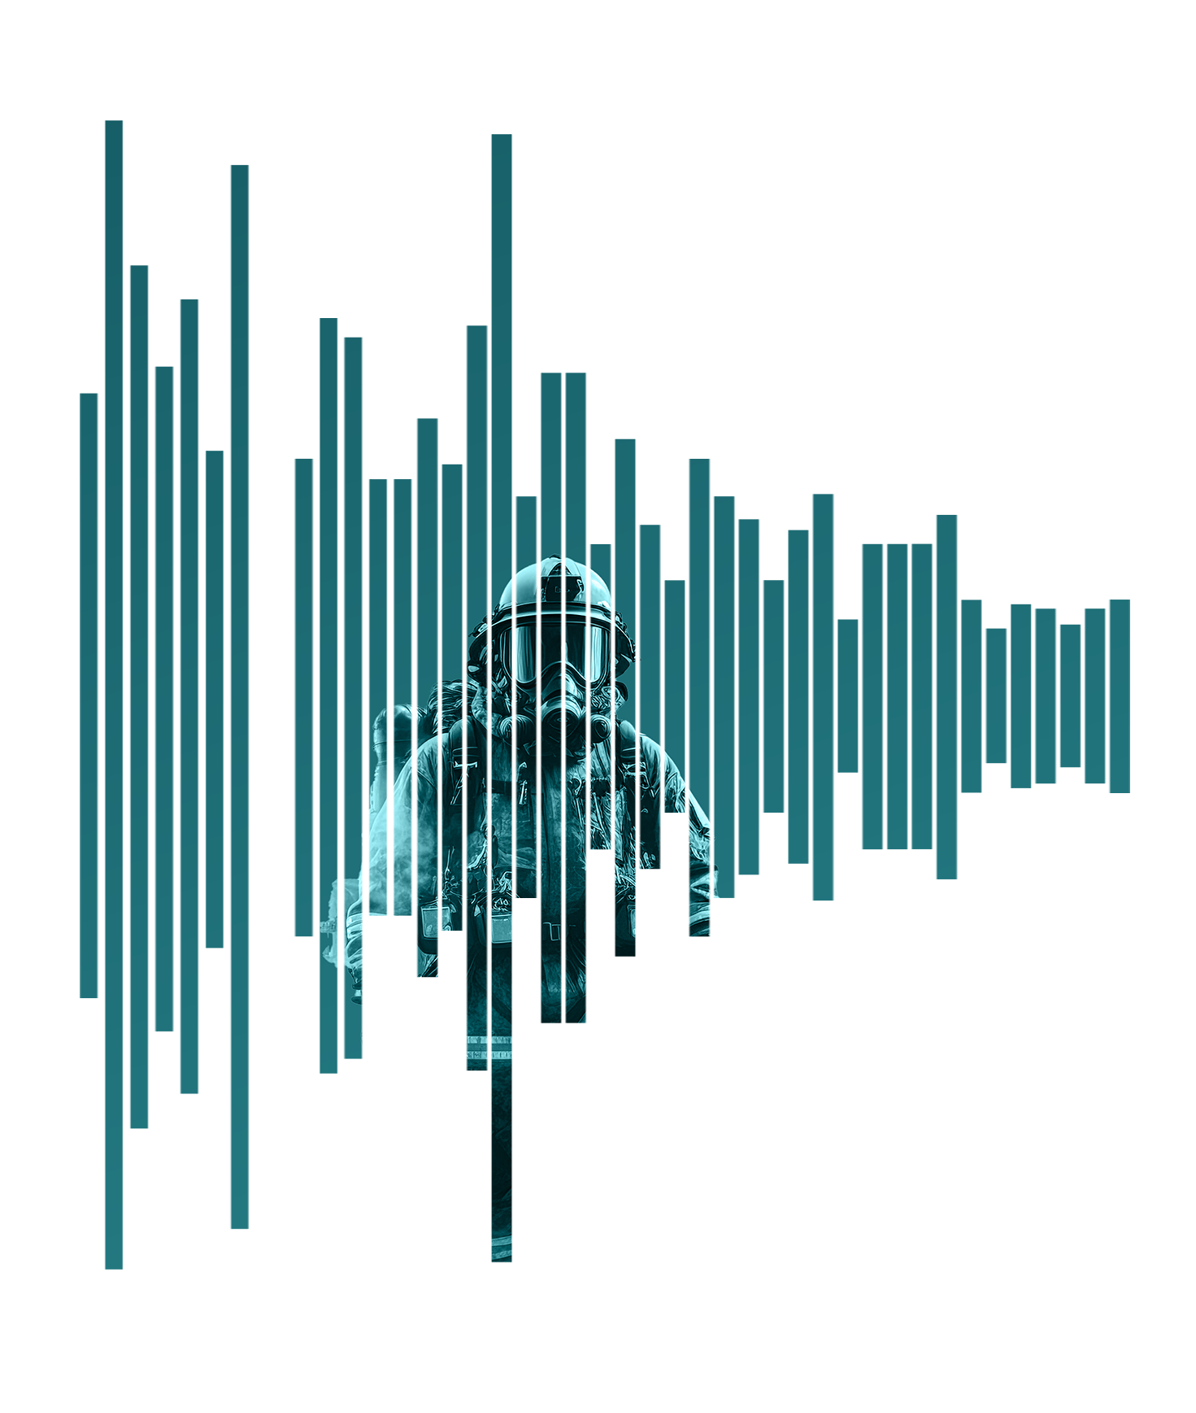
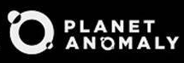
1980s average
75 days
113
111
NO OF DAYS
104
85
78
Days between
billion-dollar disasters
74
73
71
66
64
60
64
2020s average
54
51
18 days
48
47
44
46
47
44
39
39
40
30
34
35
33
36
30
30
30
23
23
20
19
20
16
18
18
Since the 1980s, the U.S. has faced more frequent climate disasters with every passing decade. Between 2020 to 2022, the average number of days between billion-dollar disaster events within one year dropped to just 18.
13
14
No disasters in 1987 and only in 1988
2020
2010
2015
1985
1995
2005
Billion-dollar disasters are events where overall damages/costs reached or exceeded $1 billion (including CPI adjustment to 2023).
1980
2000
1990
Source: NOAA |
6

Slide 7
U.S. Inflation-Adjusted Insured CAT Losses: 1977 – 2023:H1
Ida ($36B)
TX Freeze ($15B)
Harvey, Irma, Maria
$ Billions, 2019
Hurricane
Andrew
WTC
Katrina, Rita, Wilma
Ian 2022 became the 2nd costliest insured CAT loss ever
Ian ($52.5B)
Elliott ($5.4B)
Idalia
($3-5B)
The 2020s are off to an ominous start with $85B in average annual insured losses (2020-22)
Insured Cat Losses Are Increasing At An Alarming Rate – Nearly 700% Since 80’s
Average Insured Loss per Year* | 1980-2021: $23.8 Billion | 2012-2021: $44.1 Billion
Sources: NAIC data sourced through S&P Global Intelligence; Insurance Information Institute.
7

Slide 8

Casualty Market Major Disruptors
Auto Liability
Workers Compensation
General Liability & Excess Liability
Cost of vehicles(inflation)
Cost to repair (technology)
Fatality Trends
Distractive Driving – Cell Phones
Claims Frequency and Severity Trajectory
Social Inflation
Opioids
Mental Health
Aging Workforce
Medical Cost Inflation
Cancer & PTSD Presumptions
Workplace Violence
Medical Service Delays
Out of State Exposure
Increase in Catastrophic Losses
Punitive Damage Awards
Organized Plaintiff Bar
Personal Injury Trends
Litigation Financing
Aging Infrastructure
Sexual Misconduct
Law Enforcement Liability
Notes:
Keep and updated content.

Slide 9
Upward Trend in Liability Claims
Billions
11% Annual Growth for a Decade
Sources: NAIC data sourced from S&P Market Intelligence; Insurance Information Institute.
9
Notes:
Why is this growing?
More accidents
Bigger claims
Can’t tell by looking at this

Slide 10
Thank you!
Questions?
Please contact us if you would like a copy of this presentation.

