Slide 1


To Catch a Thief
Insurance Investigations

Slide 2
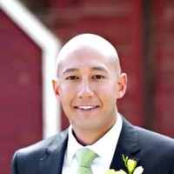
Speaker
Tim Muraki
COO
SIU Consultant Group
(916) 621-9849
tmuraki@siuconsultantgroup.com
Notes:
2

Slide 3
Full-service private investigation firm
Headquartered in Pleasanton, CA
Offices in Sacramento, Fresno, Newport Beach
Full time W2 investigators statewide in CA
Leverage latest in investigation technology
Services offered: Surveillance, AOE/COE, Social Media, Background, Fraud – FD-1 Filing & Fraud Packaging, Medical Canvassing

Slide 4
Overview
Our plan for today
Definition of Fraud & Abuse
Fraud Types
Elements of Fraud
CDI & District Attorneys
Anti Fraud Investigations and Methodology

Slide 5
Abuse vs. Fraud
Our plan for today
Abuse: - Any practice that uses workers’ compensation system in a way that is contrary to the intended purpose. Abuse includes some behavior that is criminal and some that is not. Criminal abuse is called Fraud.
Fraud: - Someone knowingly lies to obtain some benefit or advantage to which they are not otherwise entitled.
The Difference?: - An outright lie or misrepresentation.

Slide 6

Where’s the lie?
To physicians – PTP, PA, QME, NCM, PT, etc.
To claims handler
To an investigator
During deposition – under oath carries penalty of perjury

Slide 7

4 Elements of fraud
M.I.L.K.
Lie – A false representation
Knowledge – The lie must be knowingly made
Intent – The lie must be for the intent of obtaining a benefit that isn’t due
Material – The lie must make a difference. It must matter.
M.I.L.K.

Slide 8
Fraud Types
Non-Comp Injury (Fake or Non-Industrial Injury)
Apportionment (Hiding prior injuries/preexisting conditions)
Physical Exaggeration
Life Pension

Slide 9
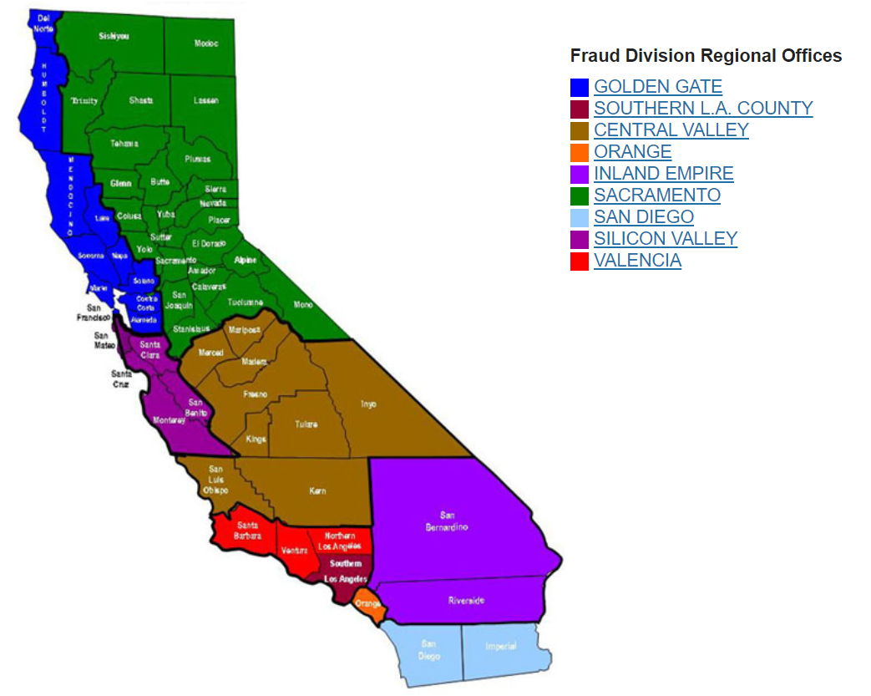
CDI – California Department of Insurance
CDI – Fraud Division http://www.insurance.ca.gov/0300-fraud/0100-fraud-division-overview/
  9 Regional Offices
  275 Dedicated staff
  Experts in Fraud
  Detectives trained in criminal investigations
  Conduct investigations
  Make arrests

Slide 10
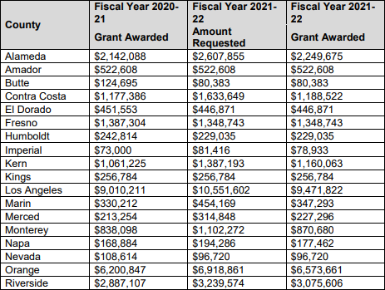

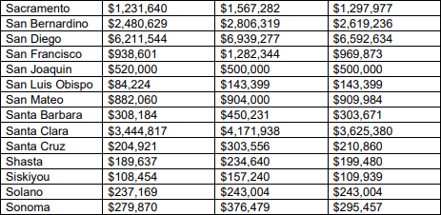

California District Attorneys
District Attorney Grant Funding = 37 Counties totaling $48,442,512

Slide 11
Key Take Away
Looking at the numbers
Insurance fraud perpetrated in the US = Massive!! $80billion!!!
https://www.insurancefraud.org/statistics.htm#1
Resources allotted to state agencies to combat fraud = Not so massive
Reality = Insurance fraud convictions are tough to get!
Burden of proof is high in a criminal setting. Unanimously convince 12 jurors that someone is guilty beyond a reasonable doubt
Despite that, investigations should still be utilized to combat insurance fraud

Slide 12
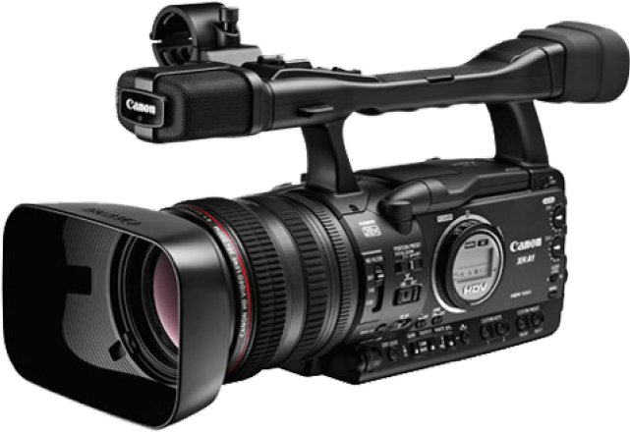
Surveillance
Why conduct it?
Combat physical exaggeration, malingering and shut down the claim
Return injured worker back to work – Stop TTD, Obtain MMI declaration, shut down the claim
Overpayment in TTD
Lower Impairment Ratings
Leverage favorable settlement
  At depo
  MSC

Slide 13
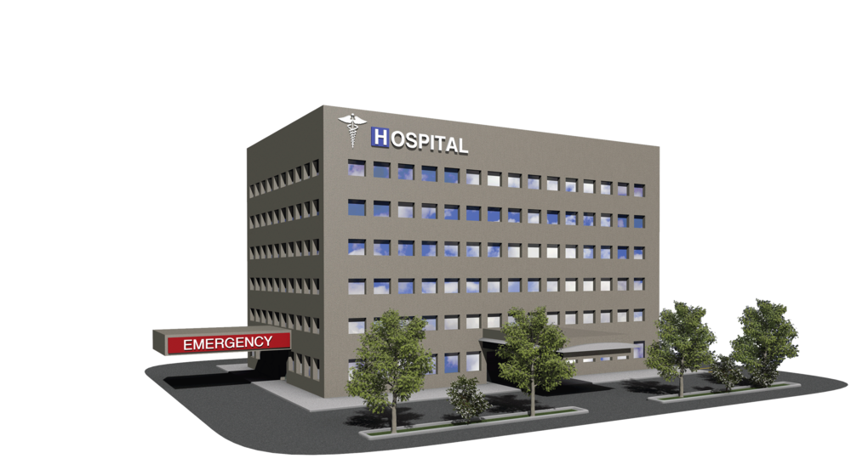


Surveillance
Scheduling -When to conduct it
Tips for better outcomes on surveillance:
  Birthdays
  Holidays
  In conjunction with medical appointments
  In conjunction with hearings
  In conjunction with depositions
  Witness tips
  Social media/internet findings
3 day assignments prove the most fruitful. Avoid half days or activity checks

Slide 14
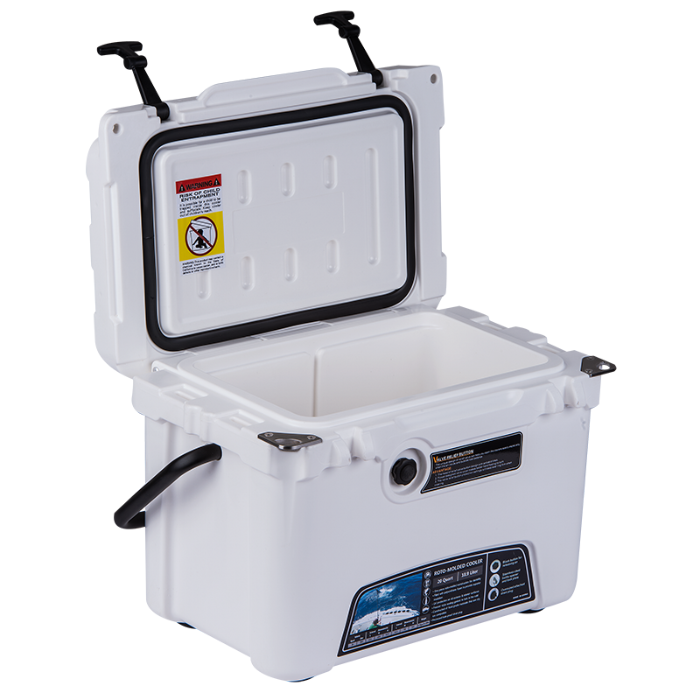
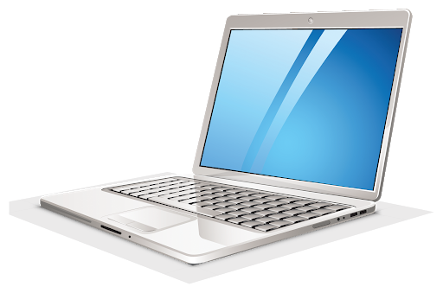
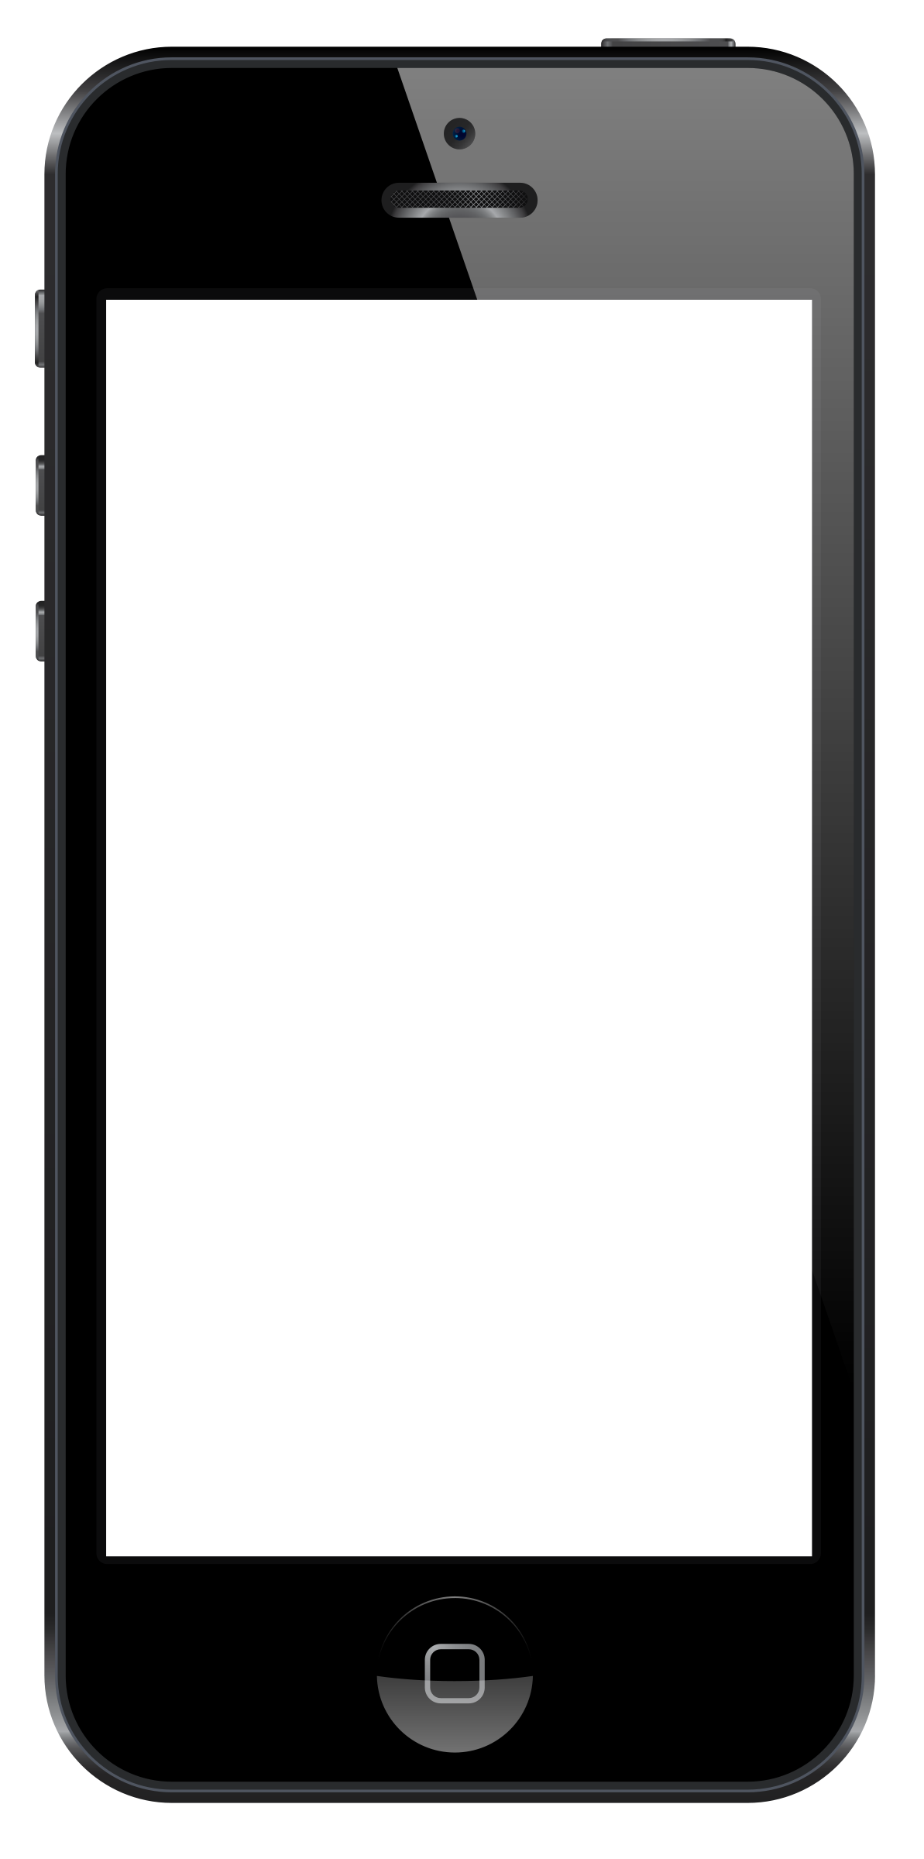
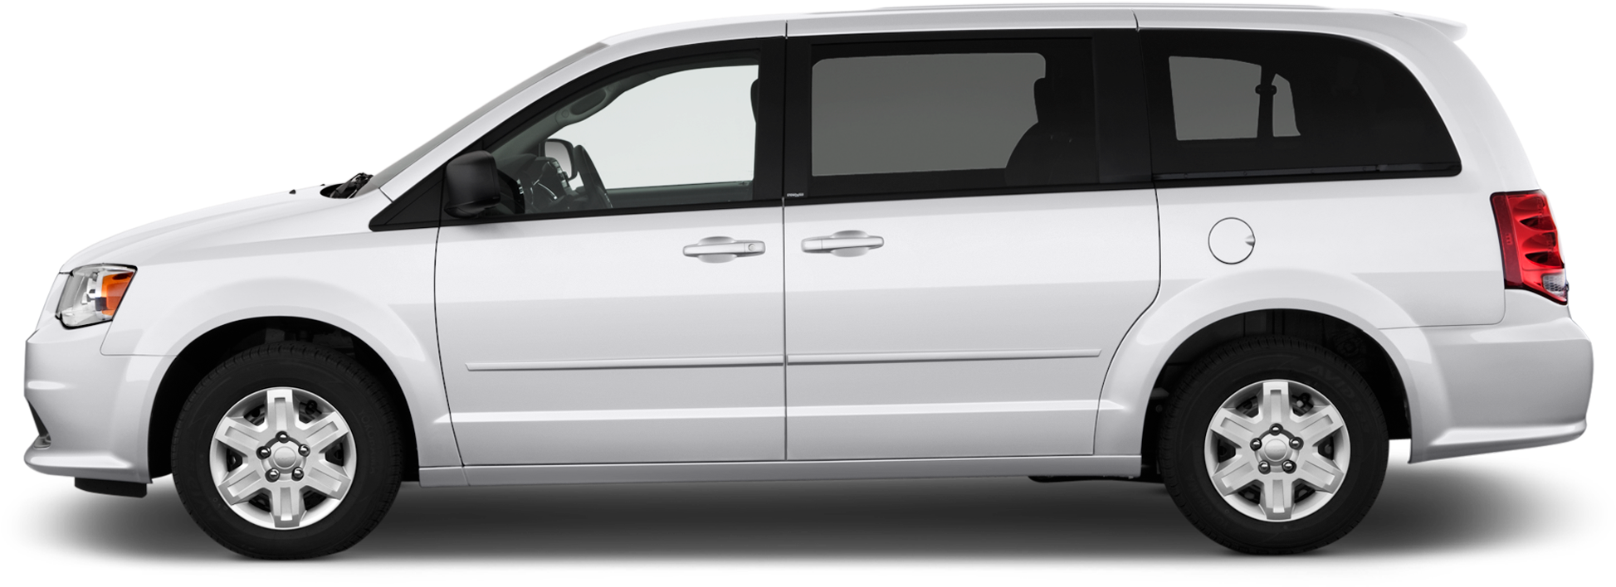
Surveillance
Standard Equipment

Slide 15
Surveillance
How to conduct it
Pre-Surveillance Background!
  Background – Clear, TLO Accurint
    Address
    Civil & Criminal
    Relatives & Associates
    Businesses & Work Affiliations
  Social Media & Internet
  Vehicle search

Slide 16
Surveillance
How to conduct it
Standard day – 8 hours onsite
Early start time day 1 – Typically 6:00am
  Field worker – 4:30am
Change subsequent days’ start times & days based on prior days’ results

Slide 17
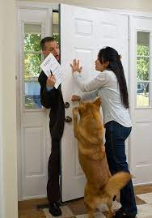
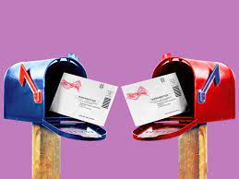
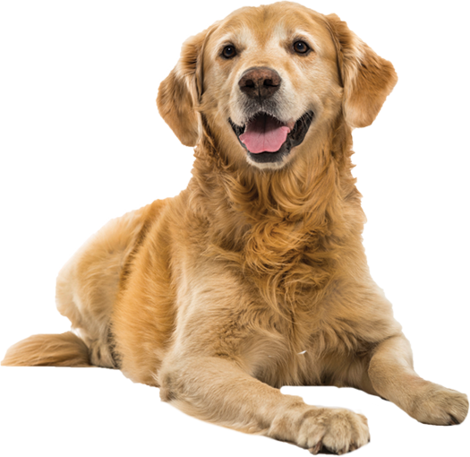
Surveillance
How to conduct it
Once onsite run license plates with DMV
Patiently wait and watch like a hawk!
Attempt to confirm presence at residence (pretext)
Lost Dog
Package Delivery or Mail Mix Up
Door to Door Salesperson

Slide 18

Surveillance
Case Example – Bad Bus Driver
50-year-old male Paratransit Operator
Rear ended while driving bus
Injured head, neck, shoulders & back
TTD
Claimed injuries were worse
Required use of wheelchair

Slide 19
Surveillance
Case Example – Bad Bus Driver

Slide 20
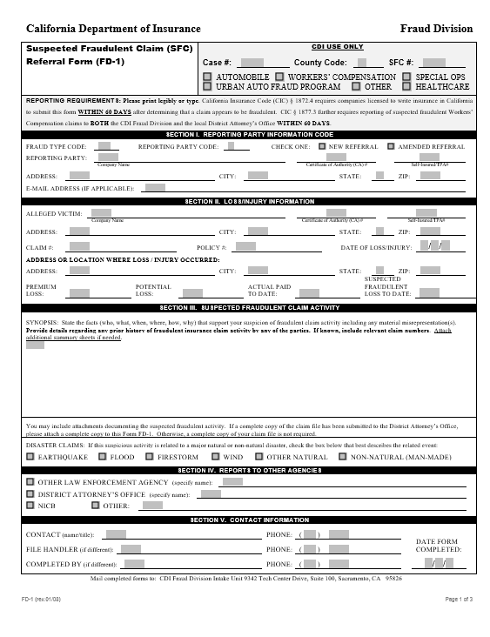
FD-1

Slide 21
Surveillance
Case Example – Bad Bus Driver
Surveillance was conducted on 3 different medical appointments with the same results
It was decided against taking his recorded statement
Video was disclosed to PTP
PTP did not reference surveillance video in PR-2 or change any material opinions; however, told IW about the film
IW was terminated from employment
Union was involved to dispute termination
Union was shown surveillance video and dropped dispute
FD-1 was filed with CDI & Sac DA’s office
Criminal complaint was filed against IW

Slide 22
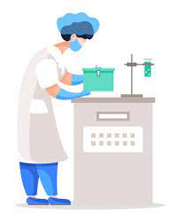
Surveillance
Case Example – Sterile Technician
49-year-old Sterile Processing Technician
Carrying heavy instrument tray in decontamination
Strained lumbar back
TTD for 3 months
Claimed injury was getting worse.
Went from using crutches to now using a walker

Slide 23
Surveillance
Case Example – Sterile Technician

Slide 24
Surveillance
Case Example – Lunch Break Depo
36-year-old seasonal ag worker
“Tripped” 9 days after DOH
Injured back, left thigh and left hip
Initially declined treatment and worked through the end of harvest season
When harvest season ended, she requested treatment. Doctor immediately took her off work and TTD benefits commenced
During initial telephonic interview with adjuster she denied working elsewhere
MRI of back and hip were normal
In June, she complained of groin pain. Doctor noted subject complaints outweigh objective findings.

Slide 25
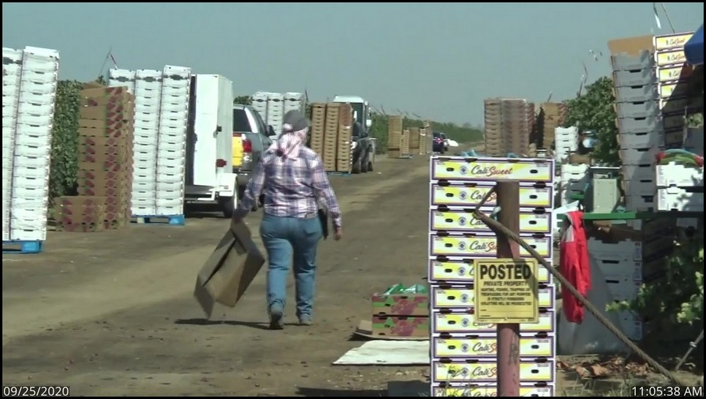
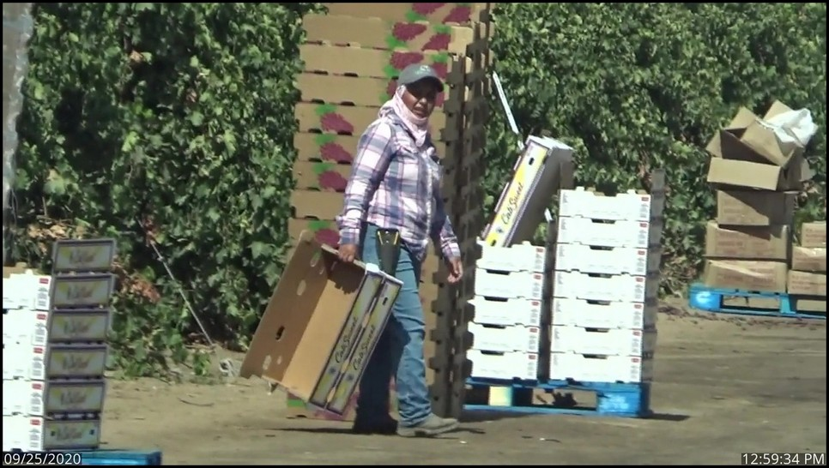
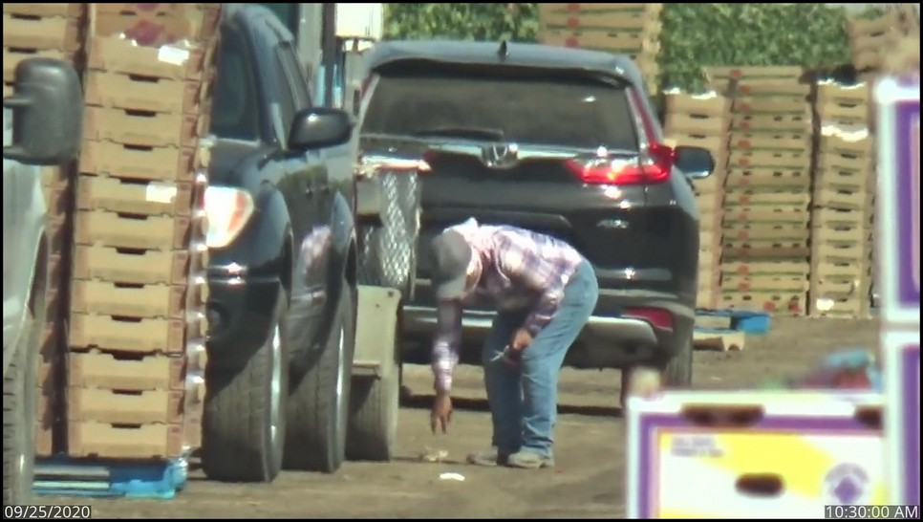
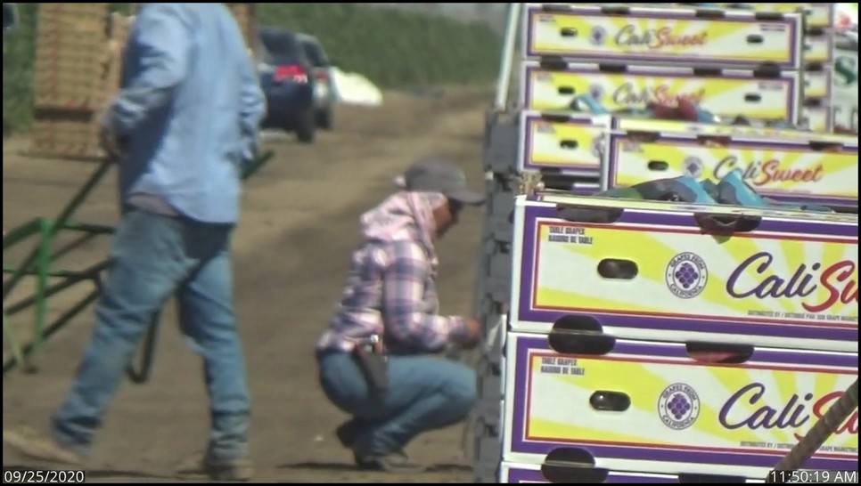
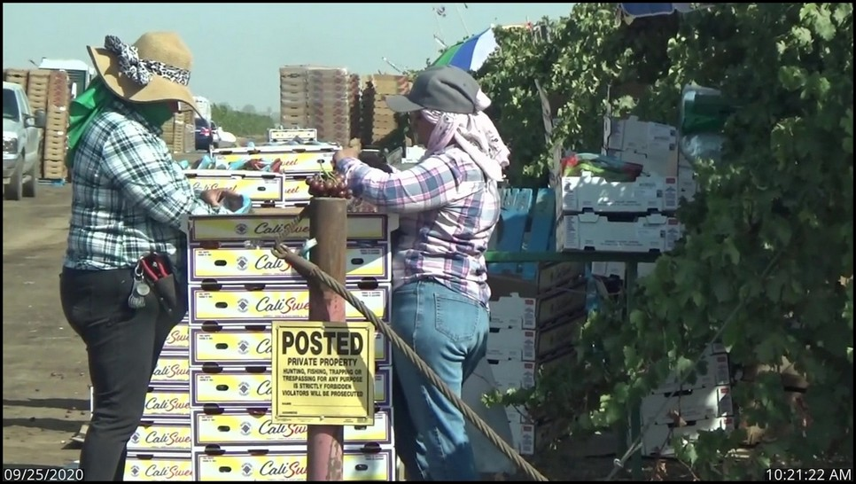
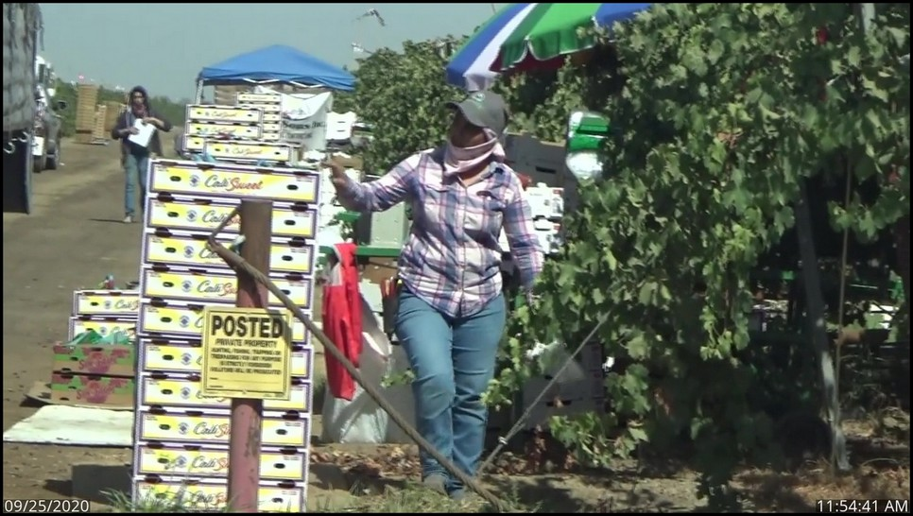
Surveillance
Case Example – Lunch Break Depo
On September 25, 2020 applicant was observed leaving the house and dropping the child off at a second residence, then driving to a grape vineyard where she worked until 1:30 pm.

Slide 26
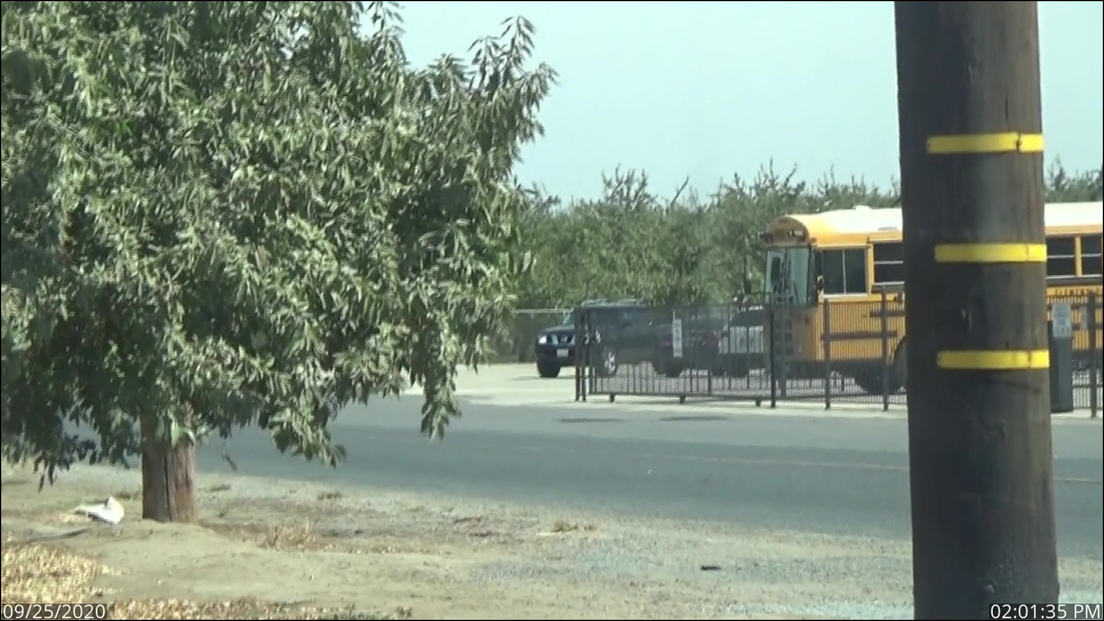
Surveillance
Case Example – Lunch Break Depo
Applicant was observed driving to a school and was observed talking on her phone.

Slide 27
Surveillance
Case Example – Lunch Break Depo
Applicant attended the deposition using her phone but was asked to relocate due to connectivity issues.
The deposition resumed and applicant confirmed she was in her car and testified she had driven to a co-worker’s place of work to borrow his phone.
Surveillance confirmed applicant drove back to the grape vineyard and then drove to a different location until the deposition concluded.
Applicant denied any employment.
Applicant confirmed telling doctors on 4 different dates that she had not worked since the DOI.
SDT resulted in earnings records from 10 different employers using 5 different names and 5 different social security numbers in a 2 year period.
On April 5, 2021 the Tulare County District Attorney filed a Felony Complaint alleging one count of Insurance Fraud (Ins Code 1871.4) and one count of Insurance Fraud (PC 550(B)(3).

Slide 28
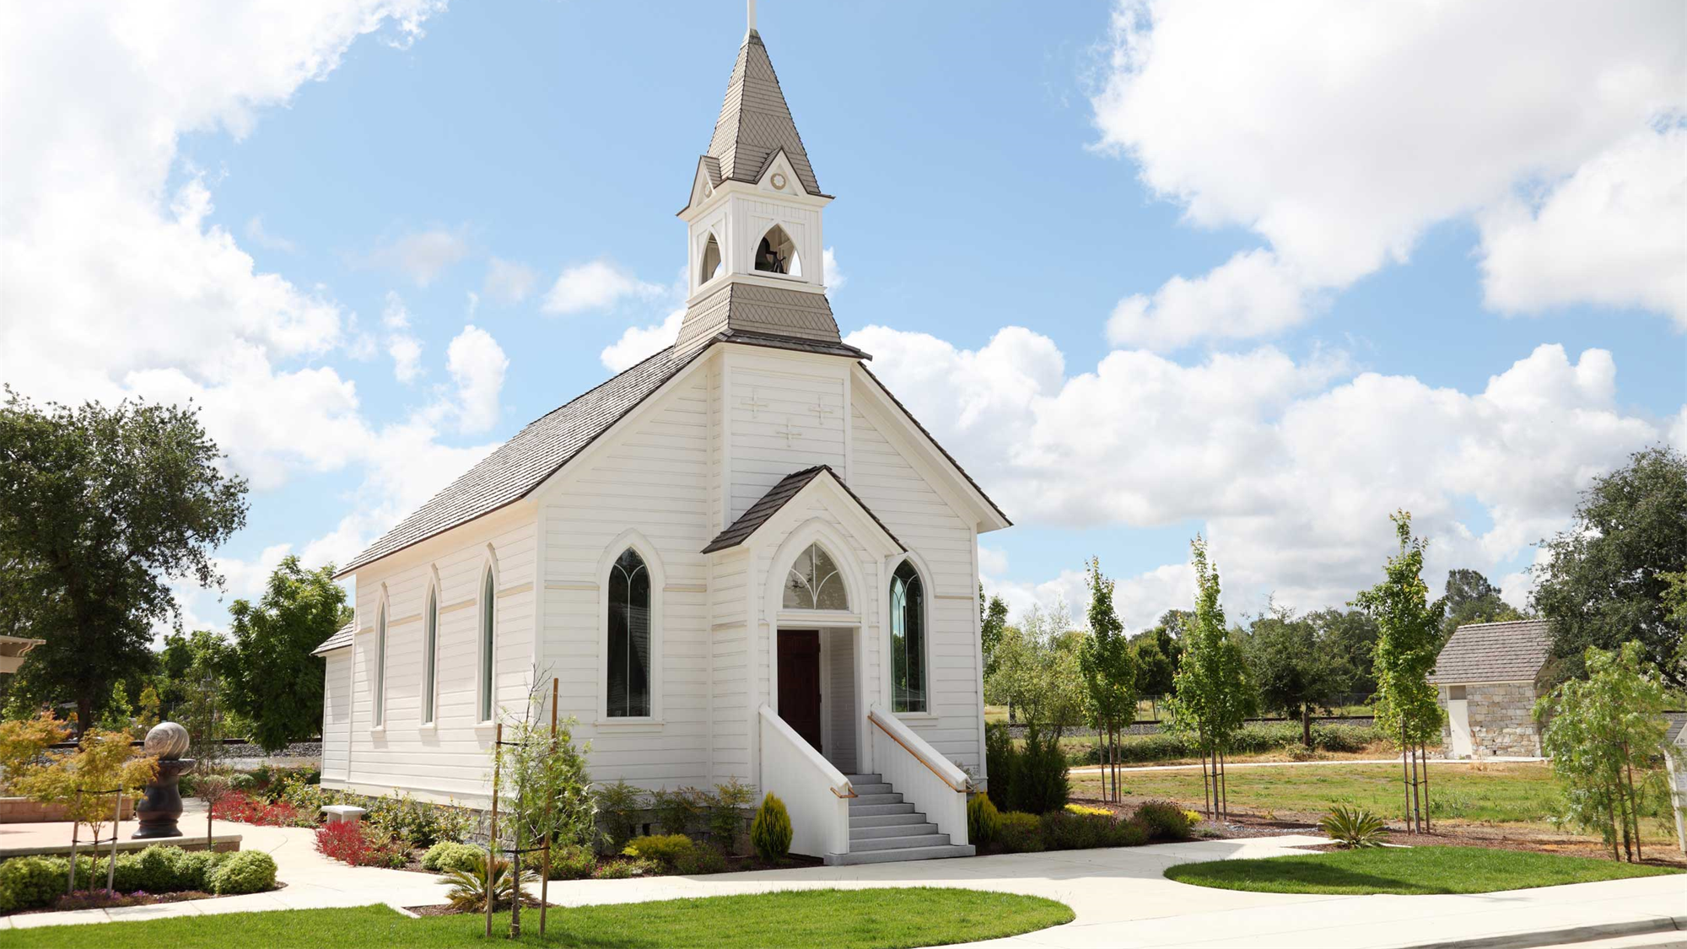
Surveillance
Privacy Laws
No filming inside a church
or religious event

Slide 29
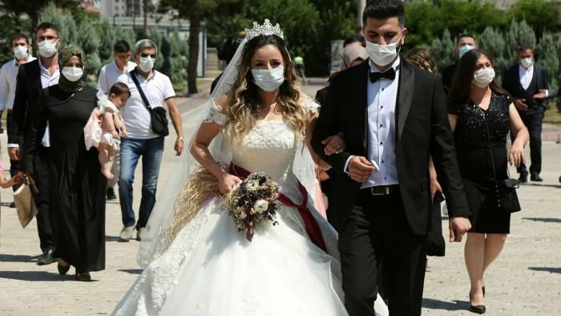
Surveillance
Privacy Laws
No filming at a wedding
No filming inside a church
or religious event

Slide 30
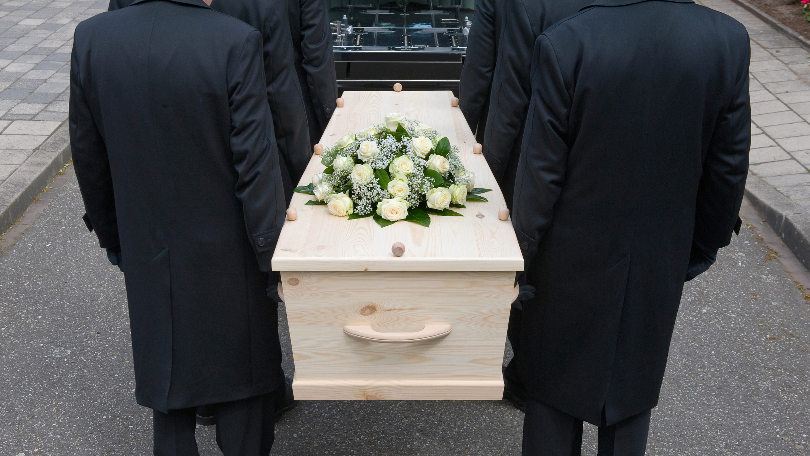
Surveillance
Privacy Laws
No filming at a funeral

Slide 31
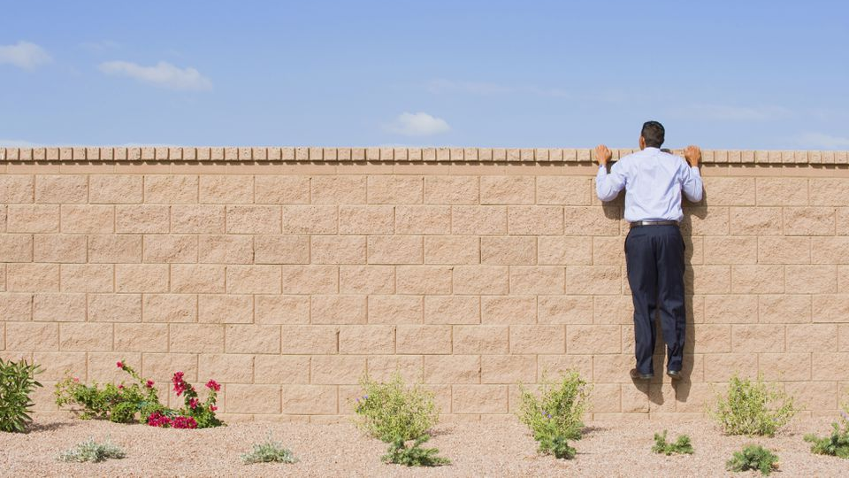
Surveillance
Privacy Laws
No looking or filming over fences

Slide 32
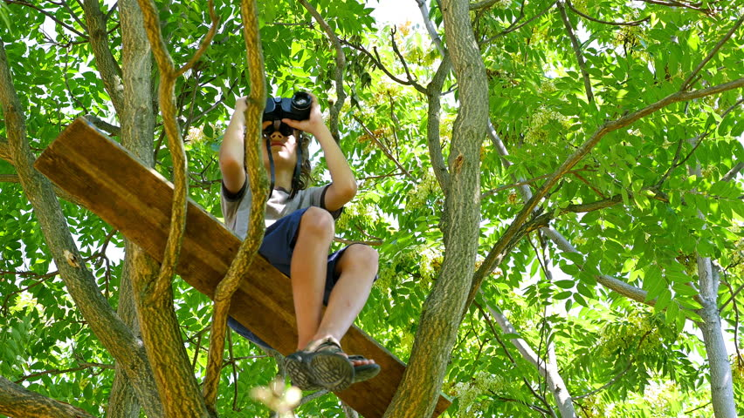
Surveillance
Privacy Laws
No climbing up trees to look or film

Slide 33
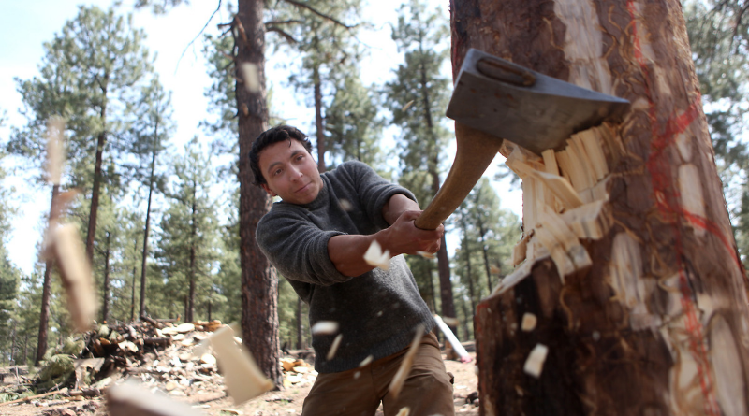
Surveillance
Privacy Laws
No chopping down trees

Slide 34
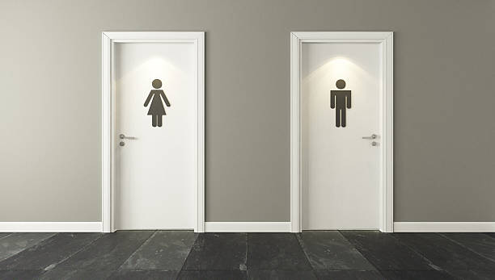
Surveillance
Privacy Laws
No filming in restrooms or locker rooms

Slide 35
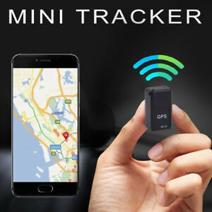
Surveillance
Privacy Laws
No usage of gps trackers on subject vehicles

Slide 36
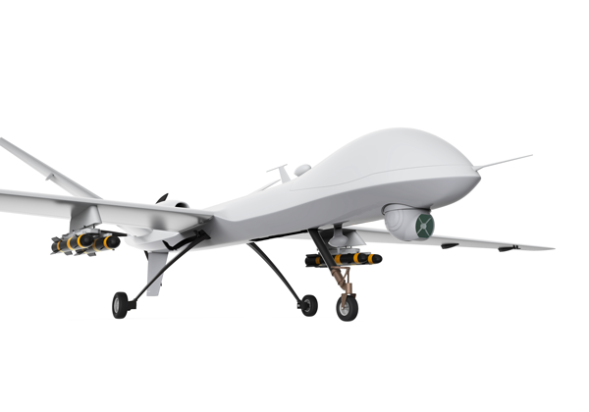
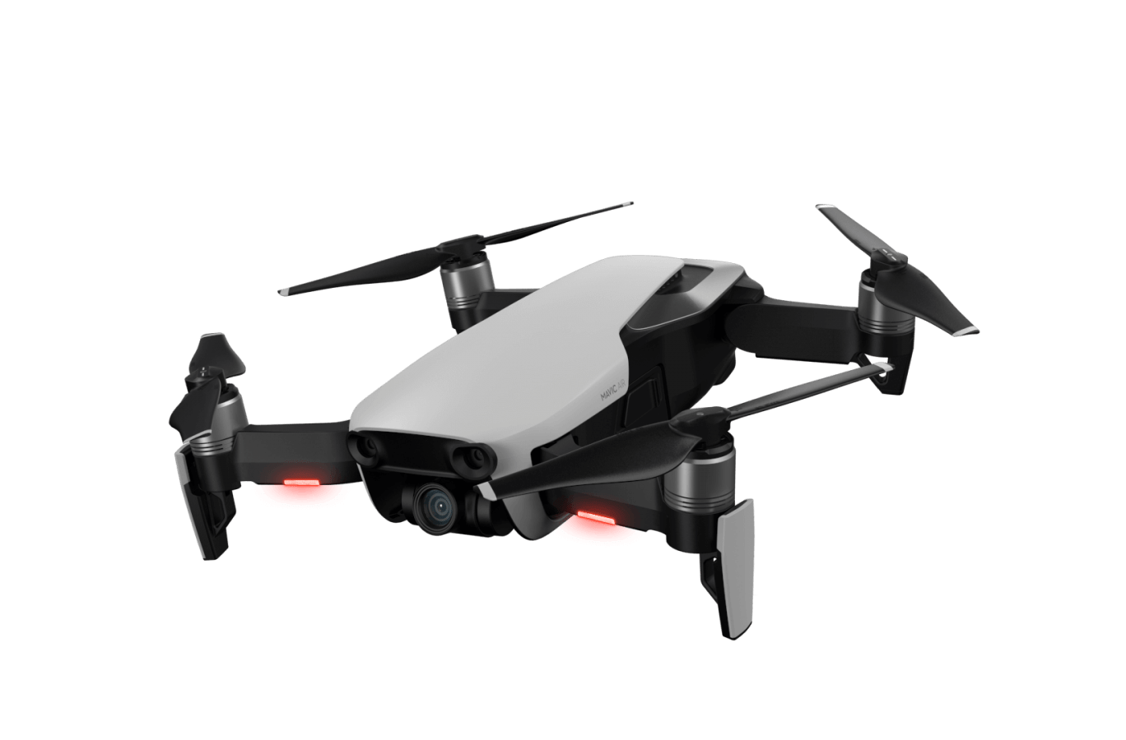
Surveillance
Let’s Talk About Drones

Slide 37
Recorded Statements
Why use them?
Identify affirmative defenses!
LC5705 - Burden of proof rests upon the employer to establish them
  Independent contractor vs. employee
  Intoxication
  Willful misconduct
  Horseplay
  Statute of Limitations
  Self inflicted injury
  Initial physical aggressor
  Coming and going rule
  Post termination
  Prejudice to the employer by failure to give notice (LC5400 & 5401)
  Felonious act
  Suicide
  Good faith personnel action

Slide 38
Recorded Statements
Why use them?
  Help determine compensability
  Identify subrogation
  Identify apportionment from outside contributing factors
  Memories deteriorate! Obtain statements while memories are fresh
  Aid in discovery before claimant obtains legal representation
  Obtain signed medical release, fraud warning form, body injury diagram

Slide 39
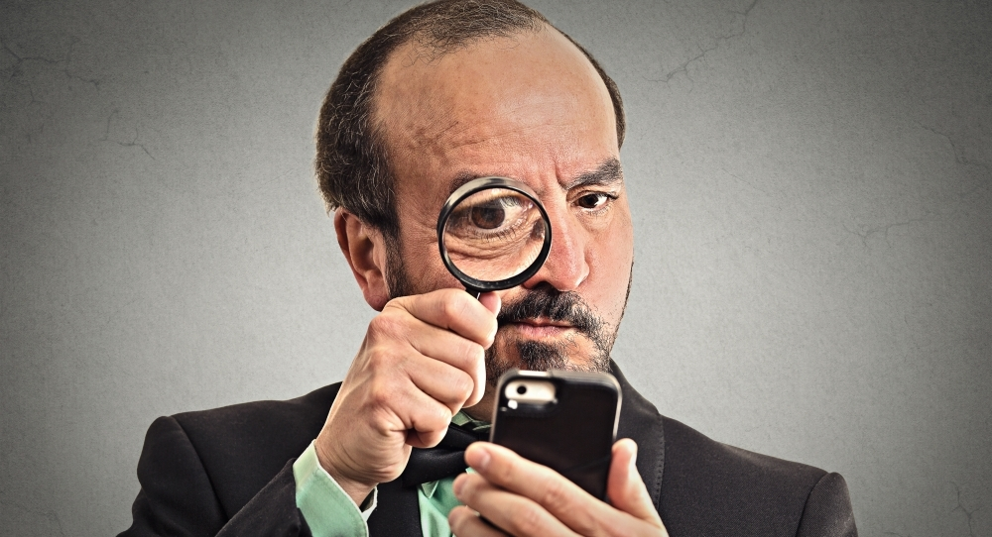
Medical Canvassing
What is it?
  Telephone & desktop investigation
  Database inquiry
  Geographic facility list generation
  Contact various establishments (medical and nonmedical) to obtain information on the claimant.
  Hospitals, pharmacies, clinics

Slide 40

Social Media
Why use it?
  Nearly everyone has a digital footprint
  Outstanding resource to increase effectiveness of field investigations
  Possible to find upcoming events, hobbies, schools, email addresses, employment, items for sale.
  Capabilities to save and preserve entire accounts with MD5 Hash
  Data Integrity: Assigning MD5 algorithms can help ensure that any changes to a document result in the generation of unique hash codes, thus exposing any attempts to manipulate potentially relevant evidence.

Slide 41
Thank you!!
Questions?

