Slide 1



Cal/OSHA Update
Patrick Corcoran MPH, CIH
Regional Manager
Consultation Services Branch
Moderated by:
Eric Lucero
Sr. Risk Control Specialist
SDRMA
March 26, 2024
SDRMA

Slide 2
Agenda
Enforcement Update
Consultation Update
Inspection Process
New & Proposed Regulations
Emphasis Programs
Q&A

Slide 3

Mission Statement
The Division of Occupational Safety and Health (DOSH), better known as Cal/OSHA, protects and improves the health and safety of working men and women in California and the safety of passengers riding on elevators, amusement rides, and tramways – through the following activities:
  Setting and enforcing standards
  Providing outreach, education, and assistance
  Issuing permits, licenses, certifications,
  registrations, and approvals
Notes:
Cal/OSHA’s mission statement can be found on Cal/OSHA’s homepage. At Cal/OSHA, our mission is to protect and improve the health & safety of working men and women in California and the safety of all passengers riding on elevators, amusement rides, and tramways. This is accomplished through the following activities:
Setting and enforcing title 8 occupational safety & health standards and regulations
Providing outreach, education, and assistance to workers on their rights and workplace protections, and to employers regarding their obligations and responsibilities
In addition, Cal/OSHA issues permits, such as construction permits, licenses to operate, certifications to perform certain work activities, registrations, and approvals.

Slide 4
Enforcement Branch
Cal/OSHA conducts inspections and investigates:
  Complaints of workplace hazards filed by employees, employee representatives, and others.
  Reports of serious injuries, illnesses, and deaths in an occupational setting.
Cal/OSHA conducts targeted inspections of employers in high hazard industries with high rates of preventable injuries and illnesses and workers' compensation losses. Cal/OSHA also conducts programmed inspections in mining and tunneling, petroleum refining, and the underground economy.
Cal/OSHA issues citations, special orders, and orders to take special action after investigation of hazards in a workplace.
Cal/OSHA issues orders prohibiting use (OPUs) where there is an imminent hazard.
Cal/OSHA issues project permits and annual permits to employers for major activities in construction and permits allowing use of diesel engines in mining and tunneling.
Cal/OSHA also issues certifications, licenses, approvals, and classifications.
Notes:
The Enforcement Branch is tasked with investigating complaints of unsafe or unhealthful working conditions or workplaces, reports of injuries or illness that are serious in nature, and workplace fatalities.
Cal/OSHA also conducts targeted inspections of employers in high hazard industries, simply meaning those with high rates of preventable injuries and illness.
Cal/OSHA Enforcement Branch may issue citations that carry a monetary penalty to employers who violate title 8 standards and regulations and can also issue Orders Prohibiting Use, known as “OPU’s” on equipment, machinery, or an entire worksite if necessary to prevent an imminent hazard that will cause injury or death to an employee.
The Enforcement Branch also issues project permits and annual permits to employers for major activities in construction and permits allowing use of diesel engines in mining and tunneling.

Slide 5
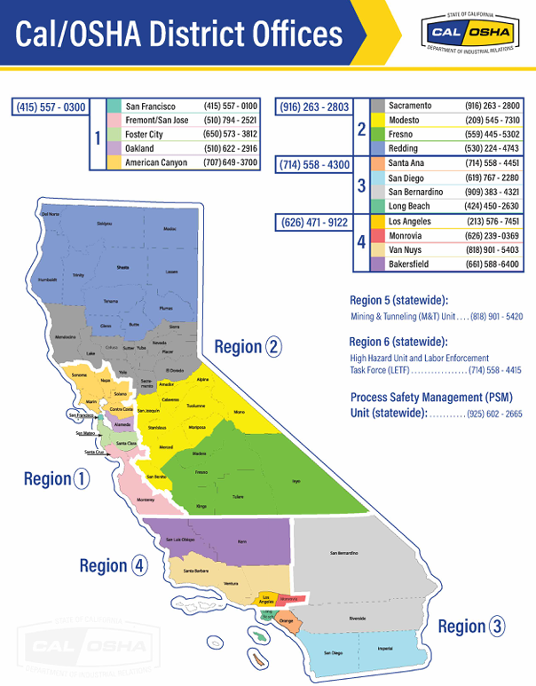
Notes:
On this slide, you can see the breakdown of the geographic regions of the enforcement, as well as the district offices that are in each region with the contact information.
CAL/OSHA IS HIRING!
The Division is in the process of establishing permanent office locations in:
Regional Office in Fresno
High Hazard Office in Fresno
District Office in Santa Barbara
District Office in Riverside
We are hiring!

Slide 6
Types of Cal/OSHA Inspections
Un-programmed Inspections
  Inspections scheduled in response to an alleged hazardous working condition identified at a specific worksite
    Accident (P&P C-36, C-170 & 170A)
    Complaint (P&P C-7)
    Referral (P&P C-90)
    Follow-Up (P&P C-15)
    Note: You must include an inspection of all ERs whose EEs are directly affected by conditions related to accident, complaint, or referral

Slide 7
Types of Inspection
Programmed Inspections
An investigation of an employer initiated by the Division based upon objective criteria.
Based on the following sources:
  Asbestos/Lead Notification Lists
  Construction Activity Permits
  Regional High Hazard Plan List
  Process Safety Management Inspection Lists
  High Hazard Industry List
  Labor Enforcement Task Programmed Inspection List
  Mining and Tunneling Mandated Inspection List
  Other sources developed by DOSH

Slide 8
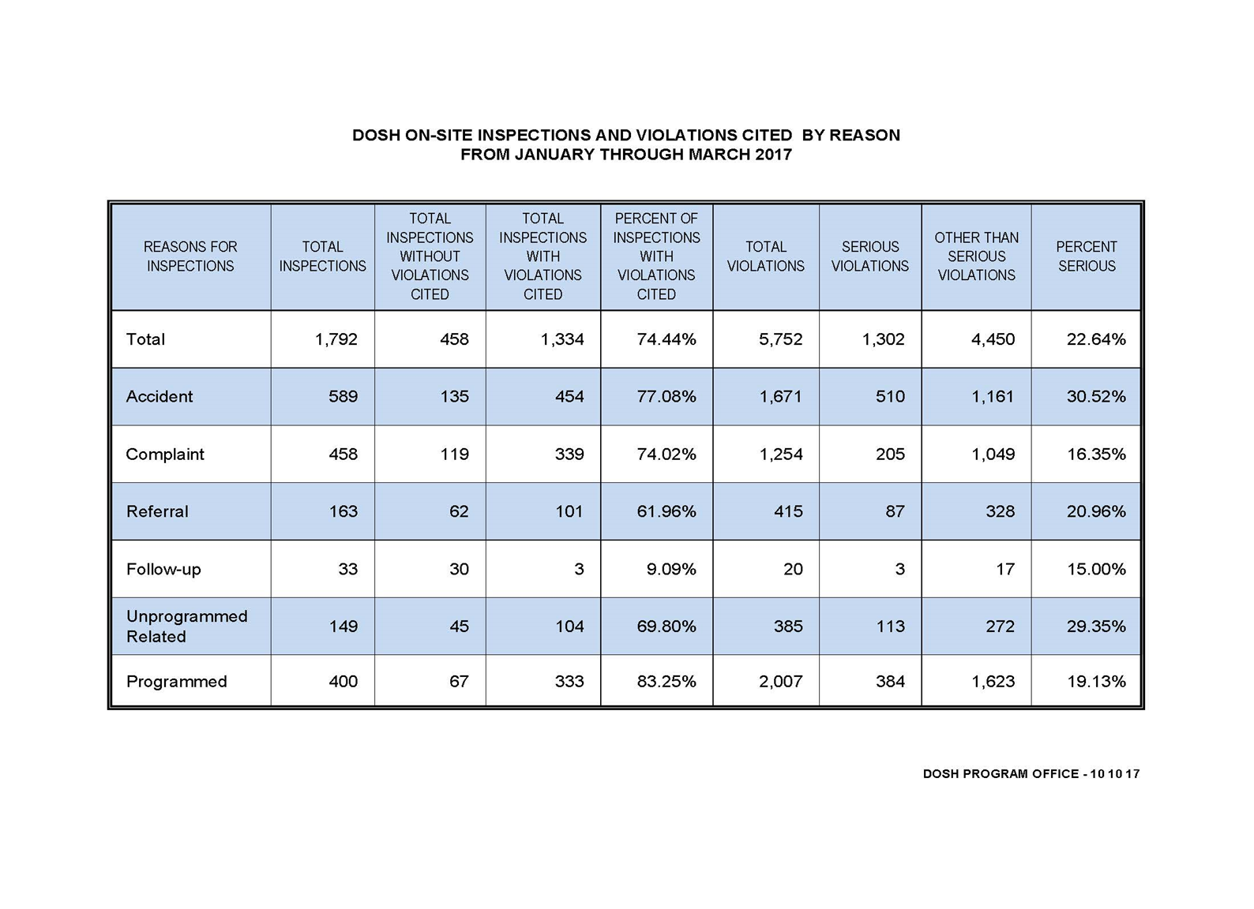

Slide 9
Initial Visit Overview
Opening Conference
Walkthrough
Interview Employees
Review of crucial documentation – (Sometimes)
  Especially documents that are required to be onsite
  Log 300, IIPP, Code of Safe Practices, Exposure Control Plan, etc.
EXIT conference/document request

Slide 10
Return Visits & Appeals
Return visits for IH monitoring, interviews, more evidence collection may occur. No longer a surprise visit.
Closing conference
Appeal
Abatement of hazards
Informal Conference
Formal Appeals
Reconsideration of appeal by OSHAB
Superior Court…

Slide 11
Consultation Service
What do we do?
On-site evaluations of small, high-hazard employers
  Health & Safety hazards,
  Mostly private employers, some public employers
Answer questions from employers on H&S matters
  Phone & email
Outreach & education to employer groups

Slide 12
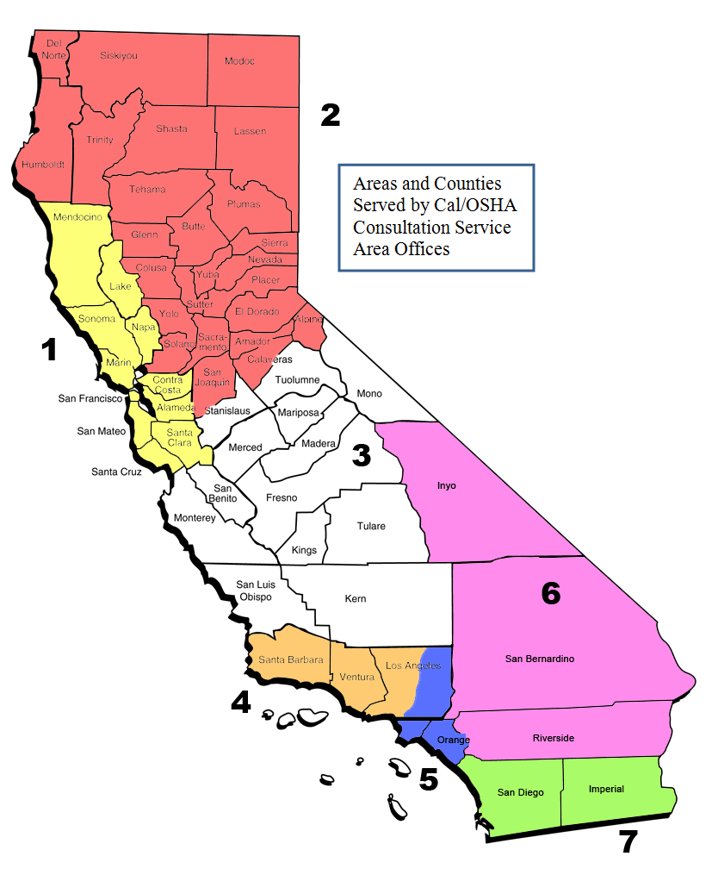
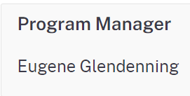
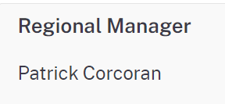
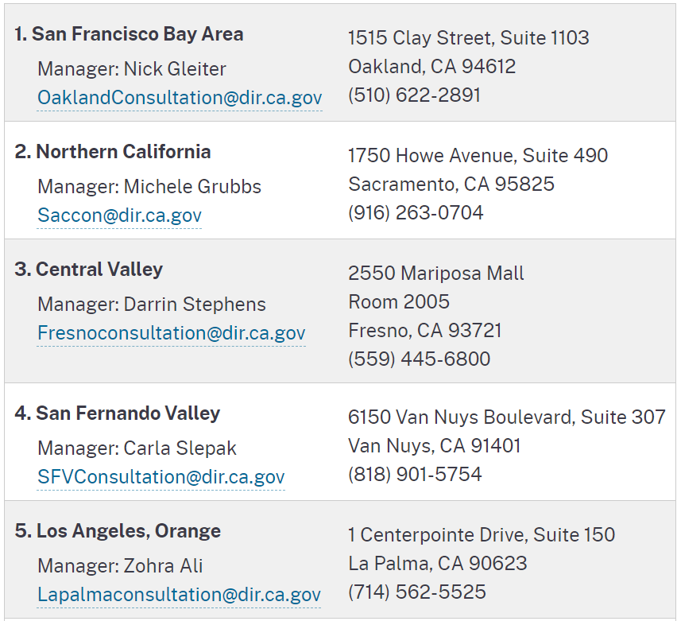
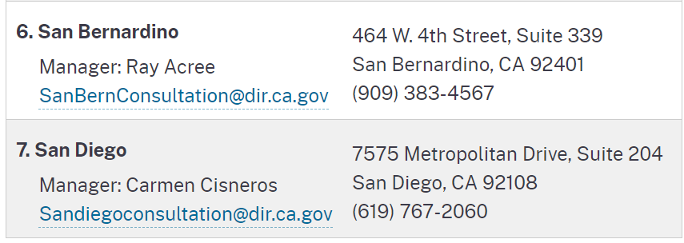


Slide 13
What is an Cal/OSHA Consultation On-site?
Program review
Injury and Illness review
On-site inspection (work must be going on)
Employee interviews
Confidential Report
Corrections for Serious items
Questions:
  What keeps employer from working with Cal/OSHA Consultation?
  Last time ER has done an internal Audit?
  Type of workplaces in Audience?

Slide 14
New Regulations in Title 8
Since 2020
Injury and Illness Prevention Program – New Employee Access Provision, Section 3203(a)(8) – Effective July 1, 2020
New Night Work Lighting Requirements for Agriculture, Section 3449 – Effective July 1, 2020
Sections 3420 and 3425 - Tree Work, Maintenance or Removal - Use of Portable Power Saws - Jul. 30, 2020
New Section 5141.1 - Protection from Wildfire Smoke - Feb. 1, 2021
Section 5204 - Occupational Exposures to Respirable Crystalline Silica -- Notice of Emergency Action: Dec. 1, 2023
Notes:
5204 ETS expires on Jun. 27, 2024

Slide 15
New Regulations in Title 8
Since 2020
3205, 3205.1, 3205.2, 3205.3 - COVID-19 Prevention - Non-Emergency Regulation, Feb. 3, 2023
Various Sections within CSO, HVESO and GISO - Consolidate Construction Safety Orders, Article 15 (Cranes and Derricks in Construction), into General Industry Safety Orders, Group 13 (Cranes and Other Hoisting Equipment), Jul. 26, 2022
Sections 1504, 1526, 3361, 3364, 3437, 3457 and 5192 - Single-User Toilet Facilities, Mar. 3, 2020
Section 3401, Section 3402, New Sections 3402.1 - 3402.3, Sections 3403 - 3410, New Section 3410.1 and Section 3411. Fire Fighters’ Personal Protective Clothing and Equipment – AB 2146 (2014)

Slide 16
Proposed Regulations
Before the OSHSB
Sections 1671.1, 1716.2, 1730 and 1731 - Fall Protection for Residential Construction (6’ rule)
New Section 3343 - Workplace Violence in General Industry (SB553)
Section 1532.1, Section 5155 and Section 5198 – Lead
  OSHSB voted: Feb. 15, 2024
New Section 3396 - Heat Illness Prevention in Indoor Places of Employment
Section 5144 Appendix A - Fit Testing Procedures (Mandatory) (HORCHER)

Slide 17
Special Emphasis Programs
California specific
2023 Special Emphasis Program: Occupational Exposure to Respirable Crystalline Silica Cut Stone and Stone Product Manufacturing
2024 Special Emphasis Program: Heat Illness Prevention

Slide 18
National Emphasis Programs –Federal OSHA
Active of interest
Trenching and Excavation
  OSHA Instruction - CPL 02-00-161 - National Emphasis Program on Trenching and Excavation - 10/01/2018
Silica, Crystalline
  OSHA Instruction - CPL 03-00-023 - National Emphasis Program – Respirable Crystalline Silica - 02/04/2020
Fall Prevention/Protection
  OSHA Instruction - CPL 03-00-025 - National Emphasis Program - Falls - 05/01/2023

Slide 19

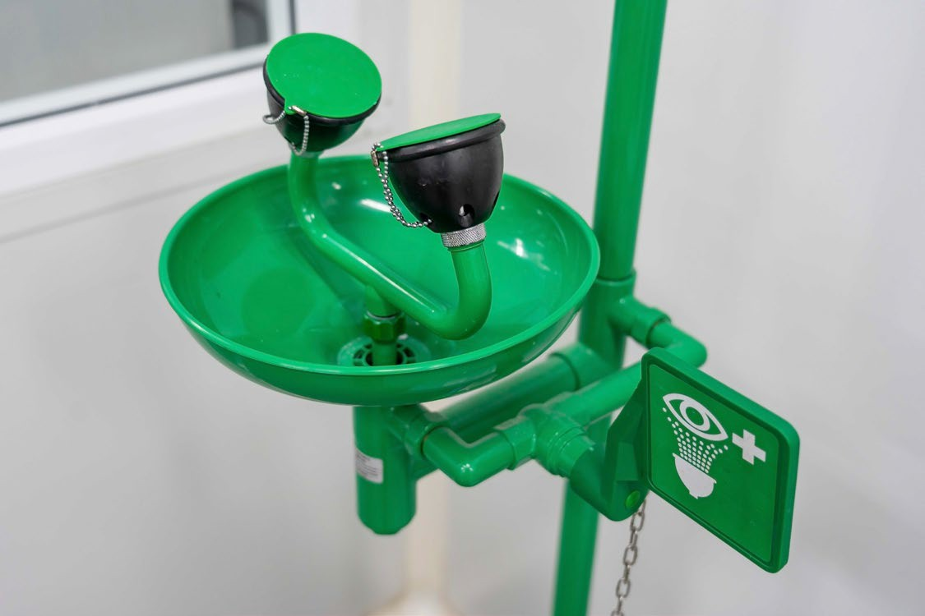
Top 10 Citations– General Industry
Presenter Notes
2024-01-10 18:47:44
--------------------------------------------
Eyewash image from Google
Rank | Description | Regulation | Frequency
1 | Injury and Illness Prevention Program | 3203(a) | 826
2 | Reporting Serious Injury or Illness | 342(a) | 395
3 | Heat Illness Prevention Program | 3395(i) | 382
4 | No Fire Extinguishers | 6151(c)(1) | 223
5 | COVID-19 Procedures | 3205(c) | 153
6 | Hazard Communication Program | 5194(e)(1) | 152
7 | Emergency Eyewash | 5162(a) | 150
8 | Permit to Operate - Air Compressor | 461(a) | 146
9 | Electrical Panels Blocked | 2340.16(c) | 128
10 | IIPP - Hazard Inspections | 3203(a)(4) | 108

Slide 20
Indoor heat rules
New proposed regulation
Heat Illness Prevention in Indoor Places of Employment
  The March 31, 2023 notice of proposed rulemaking initiated the formal rulemaking process
  Proposed regulation can be viewed here: https://www.dir.ca.gov/OSHSB/Indoor-Heat.html
Next public Cal/OSHA Standards Board meeting is on March 21, 2024.

Slide 21
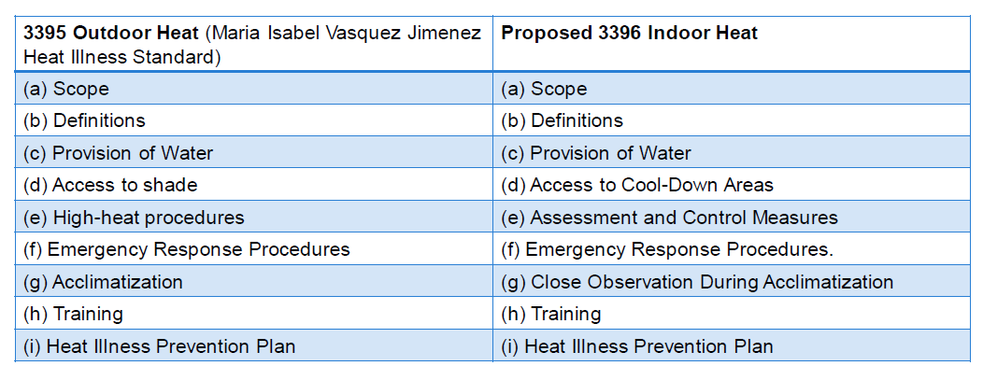
Indoor Heat Proposal
Similarities with 3395

Slide 22
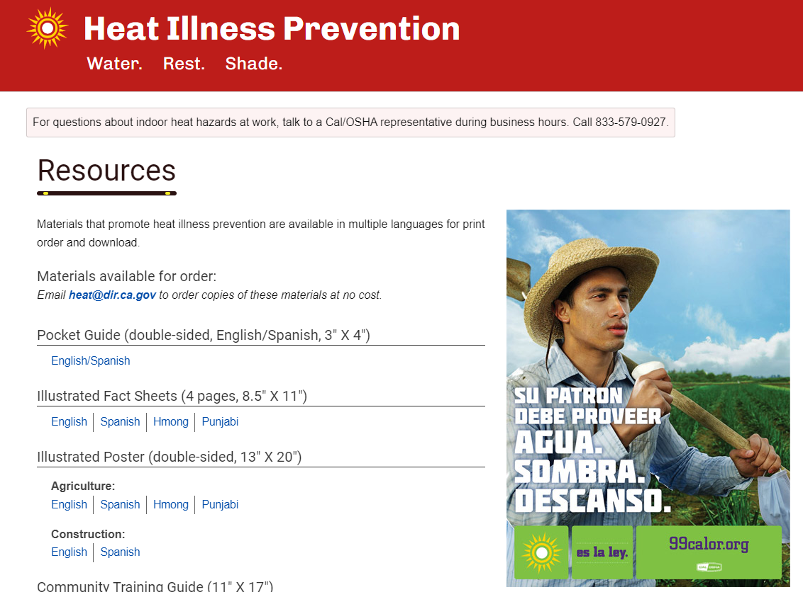
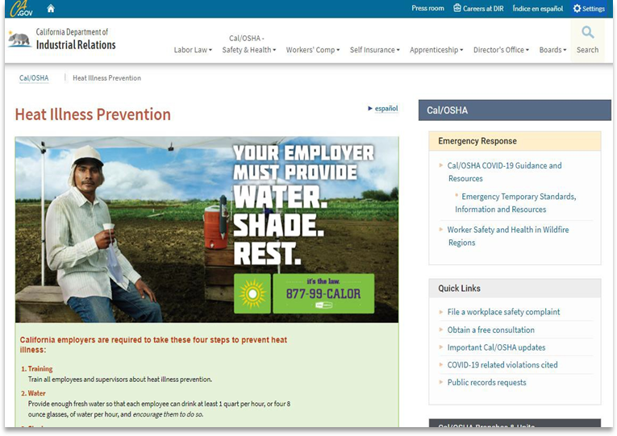
Heat Illness Prevention Resources
Multilingual educational materials can be downloaded free from the www.99calor.org website
Email heat@dir.ca.gov to get free materials mailed to you.
Visit the Cal/OSHA Heat Illness Webpage:
  http://www.dir.ca.gov/DOSH/HeatIllnessInfo.html
Contact us by email: heat@dir.ca.gov
Notes:
There are two website I want to point you to for more heat illness prevention information. The first is99Calor.org. Go check out the materials we have on 99Calor.org, then email me at heat@dir.ca.gov and order any amount of these material, such as our excellent Heat Illness Prevention pocket guide. We’ll send you as many as you need.

Slide 23
Workplace Violence Prevention

Slide 24
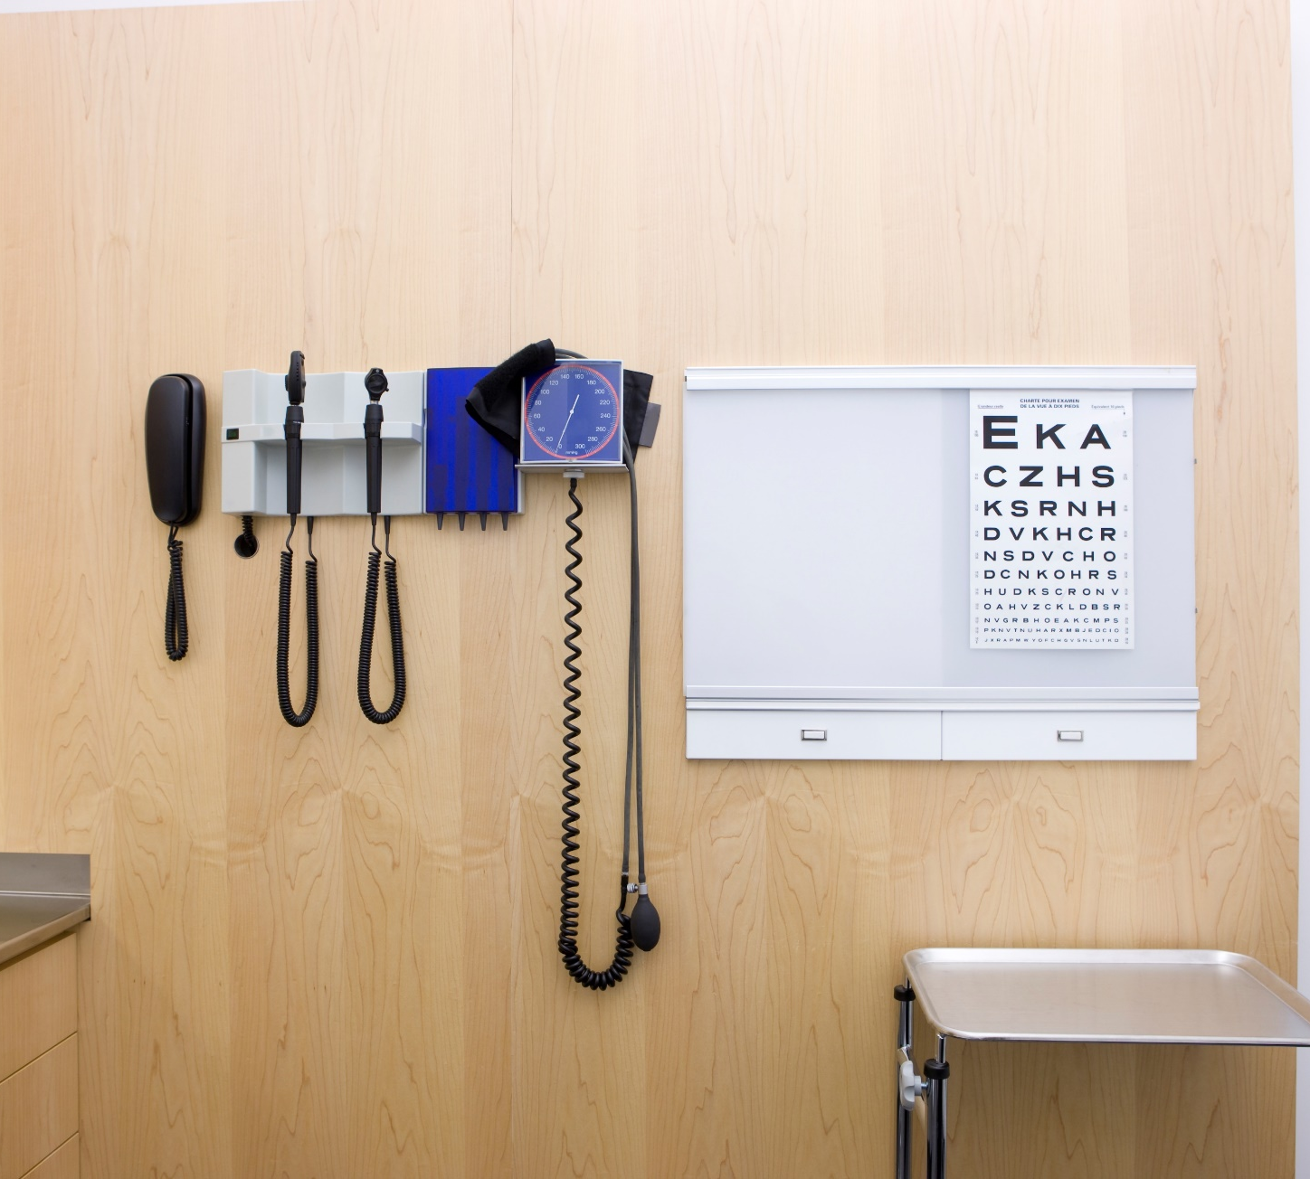
Workplace Violence Prevention
3342. Violence Prevention in Health Care
Health facilities
Home health care and home-based hospice;
Emergency medical services and medical transport, including these services when provided by firefighters and other emergency responders;
Drug treatment programs;
Outpatient medical services to the incarcerated in correctional and detention settings.
Notes:
Employers must implement the following
(c) Workplace Violence Prevention Plan – hazard ID, correction, investigations
(d) Violent Incident Log
(e) Review of the Workplace Violence Prevention Plan
(f) Training
(h) Recordkeeping

Slide 25
SB553 Workplace Violence: workplace violence prevention plan
New Labor Code Section 6401.9
An employer shall establish, implement, and maintain an effective workplace violence prevention plan.
Part of IIPP, or standalone
Written plan specific to each operation and hazard
Violent incident log
Training
Recordkeeping

Slide 26

Workplace Violence Prevention
Labor Code 6401.9
General Industry
  employers, employees, places of employment, and employer-provided housing
Notes:
Through legislation,
SB 553 passed Sept. 30, 2023. Enforced starting on July 1, 2024.
Majority of ER’s must establish, implement, and maintain a Workplace Violence Prevention Plan that includes:
Prohibiting employee retaliation.
Accepting and responding to reports of workplace violence.
Employee workplace violence training and communication.
Emergency response.
Workplace violence hazard assessments.
Other requirements, such as maintaining a Violent Incident Log.
Goal is to post new publications in Spring 2024.
Division shall propose standard by Dec. 31, 2025
Standards board shall adopt by Dec. 31, 2026.

Slide 27
Resources
Cal/OSHA Main Page: dir.ca.gov/dosh
Cal/OSHA Publications: dir.ca.gov/dosh/PubOrder.asp
Work at Cal/OSHA https://www.dir.ca.gov/dosh/jobs/
Email: @dir.ca.gov
Notes:
Also working on lead in construction standard.
New publications are now posted for silica ETS.

