Slide 1
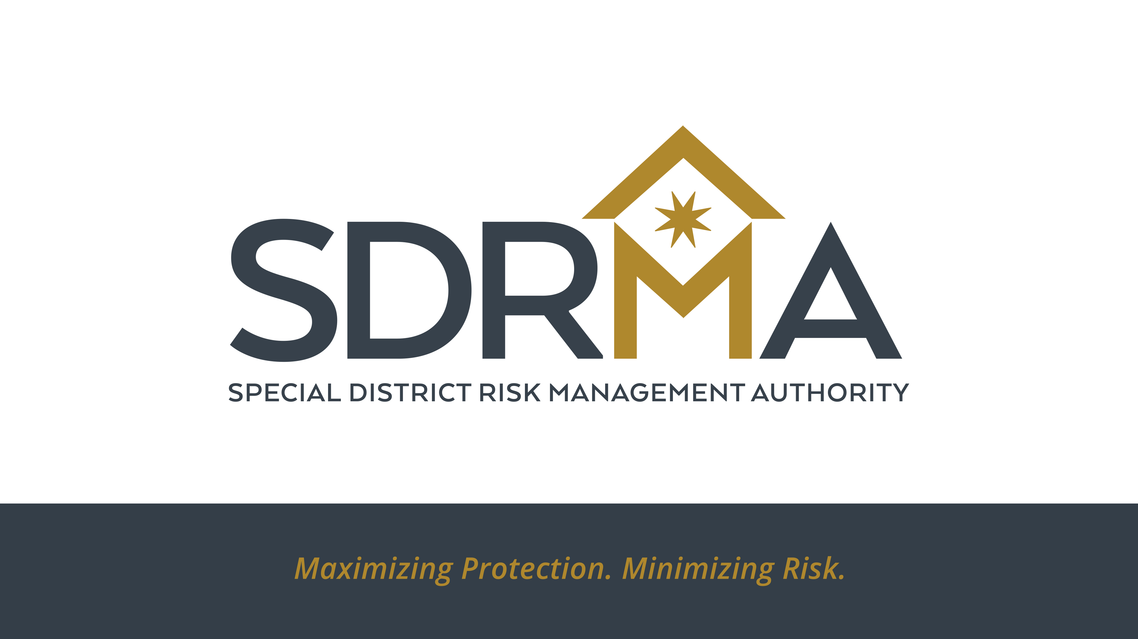

Slide 2

Contracting for Indemnification
SDRMA Education Day
March 26, 2024

Slide 3
Contracting for Indemnification
Presenters:
Wendy Tucker, Members Services Manager
Debbie Yokota, Chief Risk Officer

Slide 4
Contracting for Indemnification
Introduction
The purpose of this presentation is to help SDRMA members understand the process and benefits regarding both indemnification/hold harmless agreements with third party contractors or vendors and of becoming an Additional Insured under a contractor’s or vendor’s policy.
We will do this by going through some common questions we receive here at SDRMA to hopefully assist attendees with issues they are dealing with.

Slide 5
Contracting for Indemnification
Question 1:
Why do we need an indemnity clause in our contract when we are added as an additional insured on the vendor’s liability policy?
Insurance is only one way that the contractor can financially guarantee its liabilities. If you have an indemnity provision in your contract with the contractor, that contractor is obligated to indemnify your Entity whether or not its insurance covers the loss. This puts the burden on the contractor rather than your Entity to make certain that its coverage is sufficient and current. Therefore, make sure your indemnity language is strong, and that if the contractor does not carry sufficient or correct insurance to cover their obligations to your Entity, it does have the assets to indemnify those uninsured or underinsured exposures. In fact, the written indemnity clause in the contract is the real trigger for coverage as your contract, under normal circumstances, is an “Insured Contract” as defined under the Commercial General Liability policy (CGL). The CGL confers automatic coverage for “Insured Contracts,” (unless endorsements provide otherwise) but the Entity must have a written contract containing indemnity language in your favor prior to the loss in order to trigger coverage. As a result, the indemnity clause is crucial to trigger coverage and may even cover items not covered by the Additional Insured Endorsement.

Slide 6
Contracting for Indemnification
Question 2:
What limits should we ask of vendors/contractors?
  Ask yourself how much damage the contractor could cause if it completely mismanaged its work causing bodily injury and property damage to others. Include in your estimate, lost time, wages, extra expense incurred for repairing or replacing the work, and any future impacts. If this amount is more than the suggested amounts shown in the specifications in this manual, use the greater amount.
  Currently the standard limits for General Liability are $5 million for construction risks and $2 million for other contracts.

Slide 7
Contracting for Indemnification
Question 3:
Can we allow lower limits for small contractors when we are only using them for small jobs?
Yes; there are some very small vendors or artisans that may provide a service to your Entity and the cost of obtaining standard limits may not be possible. You should always evaluate the potential of loss, potential benefit to the organization for the service provided and finally, the vendor’s financial capacity to purchase coverage at reasonable rates. The dollar amount of an agreement would never be the sole determining factor on the insurance, however. Even in a small dollar Contract, determine if it involves any exposures that could result in significant loss such as kids, large crowds, high voltage, water, heights, ladders, scaffolding, pyrotechnics, flammable products, alcohol, etc.

Slide 8
Contracting for Indemnification
Question 4:
Should we require an additional insured endorsement as part of the contract?
  Yes. An additional insured endorsement allows the District to step into the shoes of the insured to include the insurance carriers’ duty to defend the insurer.

Slide 9
Contracting for Indemnification
Question 5:
Should we ask for a waiver of subrogation from the contractor’s insurer?
  In the case of workers’ compensation and property insurers yes; if your Entity does not do so, the contractor’s insurance company can look to your Entity to reimburse any claims cost that they have incurred defending or indemnifying its insured on your project when there is contributory negligence by your entity in the loss. “Subrogation” is the transfer to the insurance company of the contractor’s right to collect for damages from another party, in this case, your Entity.
  In the case of liability insurers no; but this is true only if your Entity is named as an “additional insured” on the contractor’s liability policy. Current case law holds that it is against public policy to allow an insurer to subrogate against its own insured, even an “additional insured.” As long as your Entity is diligent in securing and confirming its additional insured status (By insisting on receiving a copy of the additional insured endorsement), there is no reason to require a waiver of subrogation on a liability policy.

Slide 10
Contracting for Indemnification
Question 6:
Does a contractor need professional liability coverage?
A contractor needs professional liability coverage if expected under contract to provide“professional” services. The simplest way to decide is to determine whether the nature of the services provided entail “brain work” or “physical work”. If it is only physical work, then a liability policy, general and/or automobile will most likely cover all your exposures to loss. However, if the work or a portion of the work is expected to involve the use of professional knowledge, professional liability insurance is required. As an example, if a contractor is merely following blueprints in constructing a building, it would involve only physical work and a general liability policy will suffice. However, if the contractor is a “design-build” firm, or decides that it knows of a better way to construct part of the building, and it alters the blueprints accordingly, then it has crossed the line over into providing “professional” service and would then need professional liability coverage to cover a subsequent loss.

Slide 11
Contracting for Indemnification
Question 7:
Does a contractor need proof of automobile liability when hired to work on the premises?
  Yes; for the simple reason that the contractor has to use some means of transportation to reach your premises, and to transport tools, supplies, and materials. If the contractor is determined to be engaged in business on your Entity’s behalf when it is involved in an automobile accident, then your Entity may be held liable. Further, since owners of vehicles are required to carry insurance anyway, this requirement carries little burden to the contractor.

Slide 12
Contracting for Indemnification
Question 8:
If a hold harmless agreement is not necessarily legally binding, why do we need to include it?
  While a hold harmless agreement does not relieve your Entity of legal liability for your Entity’s own negligence, it may obligate the Contractor and his Insurance Company to pay for it. First, we suggest risk management professionals be precise with language. The phrase “hold harmless” is customarily used in the context of “hold harmless, defend and indemnify,” which the profession tends to refer to as an “indemnity clause” in an agreement. The paragraph with this clause is titled “Agreement to Indemnify” or similar in many agreements. Each word in the phrase “hold harmless, defend and indemnify” conveys a different duty to be performed by the indemnitor. Even if the indemnity agreement is not fully enforced, or the indemnified party has separate negligence, the written agreement to indemnify is essential to triggering contractual liability coverage under the “insured contract” definition in the ISO CGL policy of your Contractor. Your Entity can not transfer all liability from an agreement, but without any agreement to indemnify your Entity is bare as respects the contractor’s insurance.

Slide 13
Contracting for Indemnification
Question 9:
Should we require bonds in contracts that are not construction related?
  Yes; there are a number of situations when your Entity may want to require bonds. You may want to consider bonds when dealing with certain types of vendors, such as vendors that provide personalized products such as customized information systems, those that supply specific equipment designed and built for your Entity or vendors that provide specific services for your Entity. Although bonds may not be required on all vendor agreements, it is important to understand how they may save your Entity in the event that the vendor fails to deliver or lacks the funding to finish its project.

Slide 14
Contracting for Indemnification
Question 10:
What do I do if my contractor states that they are self-insured for liability, auto, and workers’ compensation, and they cannot provide a certificate of insurance?
  In the State of California, organizations that are self-insured for workers’ compensation must have a Certificate of Consent to Self-Insure issued by the State of California Department of Industrial Relations. They must also have authorization from the State to self-insure their auto exposure, but this is not the case for general liability. First, obtain copies of their documents granting them the authority to self-insure for workers compensation and automobile liability. Second, obtain a letter from the contractor that clearly states all of the requirements in your agreement apply to their self-insurance. Next, you will need to confirm that the contractor has assets available to cover any losses in the event they occur. This would normally include the review of their independently audited financial statements. Finally, you may require the
  contractor to issue a bond or a letter of credit to your Entity in an amount necessary to cover any losses. Note that the manual requires special treatment of self-insured retentions to protect the entity.

Slide 15
Contracting for Indemnification
Question 11:
The contractor states that he/she is a sole proprietor and does not carry workers’ compensation insurance as he/she has no employees, is this acceptable?
  Yes; many contractors are either sole proprietors or partnerships. You should receive a letter from the contractor stating they are either the owner of the organization or a partner, and are exempt from the State’s workers’ compensation requirements because they have no employees and agree to hold the Entity harmless from loss or liability for such.

Slide 16
Contracting for Indemnification
Question 12:
Is it possible to cover my independent contractor under my SDRMA policy?
  Not under the SDRMA General Liability policy as it contains a specific exclusion against covering independent contractors. Section FF of Liability Coverage Agreement states:
“Acts Or Omissions Of Consultants Or Contractors Who Are Not FullTime Employees Of The Covered Party: Any Claim or Suit for Personal Injury, Property Damage, Public Officials’ and Employees’ Errors and Omissions, Employee Benefits, Acts, Errors or Omissions, or Wrongful Employment Practices arising out of the acts or omissions of any consultant or contractor who is not a fulltime employee of the Covered Party, but who is appointed by the Covered Party to act as its official, agent, or other representative.”
All independent contractors should be required to provide their own liability insurance and workers’ compensation insurance (if they employee any employees) as well as indemnify the District and add the District as an additional insured to their policies.

Slide 17
Contracting for Indemnification
Question 13:
Is there any recommendation when the District and another agency agree to indemnify each other?
  This is called a mutual indemnity arrangement where each party to the contract is obligated to indemnify and defend the other party in the event any third party claim is made that resulted from or was caused by the indemnifying party.
  Consider including a “survival” clause which states that the indemnity and defense obligations “survive” the termination of the agreement for any acts or omissions that occur, or are alleged to occur, during the term of the contract.

Slide 18
Contracting for Indemnification
Question 14:
What do we need to be aware of when obtaining additional insured status by a contractor’s/vendor’s insurance?
  Pay close attention to when the policy period ends to ensure you have full coverage until the end of the job.
  If the work will extend beyond the period specified in the policy, the District should request that the policy period by extended to reflect the duration of the contract or make sure that the policy is renewed or a new policy is obtained to cover any additional time period until completion or termination of the contract with a new additional insured certificate.
  Ensure that if the contract requires the contractor/vendor to name the District on all of their policies, the District receives the additional insured certificates for all policies to include excess or umbrella policies.

Slide 19
Contracting for Indemnification
Question 15:
Should we require our contractor/vendor to have an “Occurrence” as opposed to a “Claims-Made” Policy?
  Yes. An “Occurrence” policy covers all incidents that arise due to events that occur during a policy period, regardless of when the claim is reported. This ensures that liabilities that arise due to events that occur during the term of a contract are covered by the insurance policies.
  A”Claims-Made and Reported” policy only covers incidents that happen and are reported to the insurer within the policy’s time frame, unless a “tail” is purchased.

Slide 20
Contracting for Indemnification
Question 16:
Should we add a contractor/vendor as an additional insured to our SDRMA policy?
  No. The entity or individual who is doing the actual work and taking on the risks should be the one indemnifying the hiring party and adding the hiring party as an additional insured, not the other way around.

Slide 21

QUESTIONS?

